Slide 1
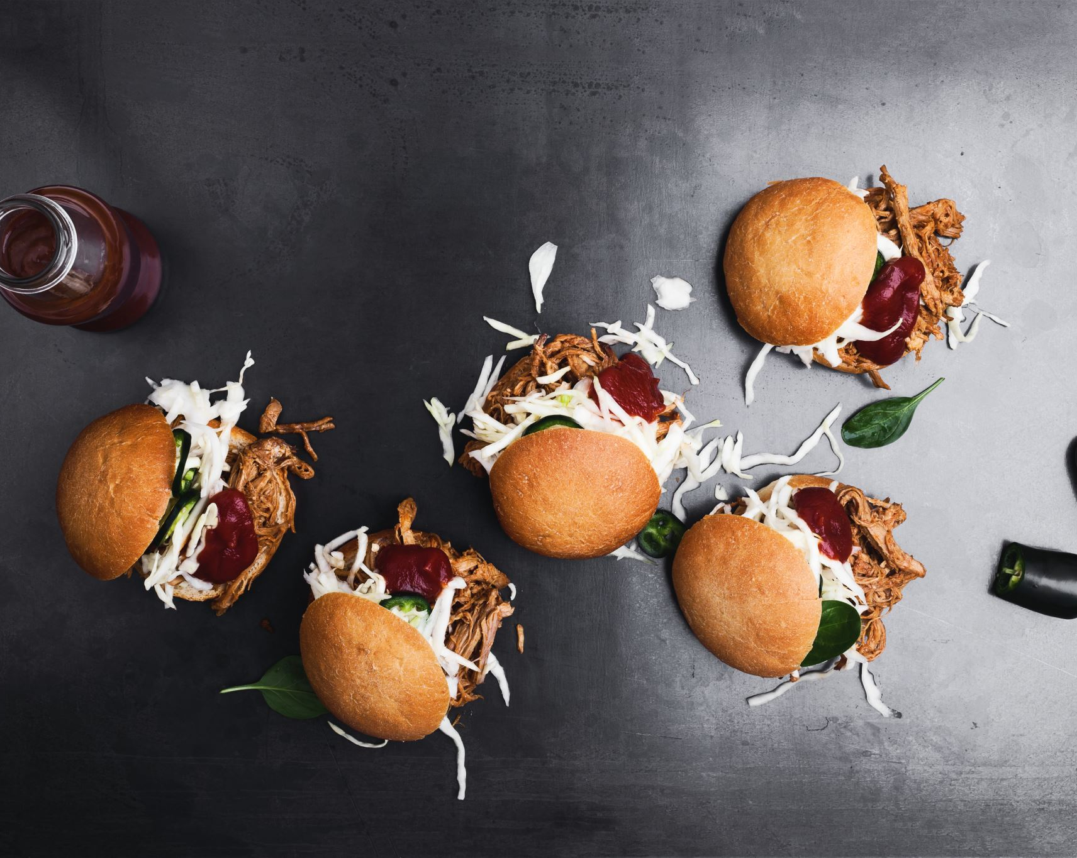
Mcdonalds Management system
Mir Aqib Hossain
Md Ainan Khan
Opening a franchise restaurant of burger

Slide 2

Introduction
We have decided to open a mcdonalds franchise and we will focus on the management system using python on
Making the Intereference of cashier using GUI python of pyQT
We will process with the data
We will try to make system, ’Low stock Alert’ where it will indicate if the ingredients limits go below the a stock threshold limit.

Slide 3

Challenges
While working on the management system of user interface:
The layout management was difficult, we had to make sure the app is user-friendly and with correct dimensions as too big will cover all the screen and too small will be not good lookibg
We had to focus on the design as the the GUI haave to look good on different screen sizes and resolutions
Data processing
We faced difficulties on changing the object to float, on the conversion of datas.
We handled missing datas appropriately, by removal or imputation.

Slide 4

CHallenges
Low Stock Alert
Data accuracy and consistency:
Real-time data syncing: we had to make sure the data is always up to data and accurately that will show the current level of stocks
Data integrity: we had to maintain consistent and error free data all the time in the system.

Slide 5

Solutions to challenges
GUI interfere python
We used relative measurements like percentages instead of absolute values for positioning and sizing UI components.
We focused on the component scaling, for each component we made sure the remain usable and good looking
Data Processing
We had to identify the missing data and used consistent methods
We had to decide on removal and imputation, inorder to avoid data loss we used imputation such as including file and delete some gaps which showed NULL
Low Stock Alert:
For the stock, we had to go through all the ingredients and put a minimum threshold for the stock.
We had to use database to automatically update the stock levels whenever there are transaction occurs like sale.

Slide 6

What Have we learned?
From the project we have learned a lot of things including
pyQT5
Team management: how we can work as a team and make a thing work
Low stock alert design; We have successfully programmed an application where it will alert the system when an ingredients go below threshold level after use
How does the inventory of a restaurant work and its management.

Slide 7


Thank you

